Slide 1
An Introduction to Artificial Intelligence
Informed Search and Exploration
Seyed Abolghasem Mirroshandel (mirroshandel@gmail.com)
In which we see how information about the state space can prevent algorithms from blundering about the dark.

Slide 2
Outline
What is informed search?
Best-first search
A* algorithm and its properties
Iterative deepening A* (IDA), SMA*
Hill climbing and simulated annealing
AO* algorithm for AND/OR graphs
Genetic Algorithms

Slide 3
Drawbacks of uninformed search
Criterion to choose next node to expand depends only on the level number.
Does not exploit the structure of the problem.
Expands the tree in a predefined way. It is not adaptive to what is being discovered on the way, and what can be a good move.
Very often, we can select which rule to apply by comparing the current state and the desired state.

Slide 4
Uninformed search
3
2
1
Start
A
Goal
Suppose we know that node A is very promising
Why not expand it right away?

Slide 5
Informed search: the idea
Heuristics: search strategies or rules of thumb that bring us closer to a solution MOST of the time
Heuristics come from the structure of the problem, and are aimed to guide the search
Take into account the cost so far and the estimated cost to reach the goal
heuristic cost function

Slide 6
Informed search -- version 1
2
1
Start
A
Goal
A is estimated to be very close to the goal
expand it right away!!
Estimate_Cost(Node, Goal)

Slide 7
Informed search -- version 2
2
1
Start
A
Goal
A has cost the least to reach.
Expand it first!
Cost_so_far(Node, Goal)

Slide 8
Informed search: issues
What are the properties of the heuristic function?
  is it always better than choosing randomly?
  when it does not, how bad can it get?
  does it guarantee that if a solution exist, we will find it?
  is the path optimal?
Choosing the right heuristic function makes all the difference!

Slide 9
Best first search
function Best-First-Search(problem,Eval-FN)
returns solution sequence
nodes := Make-Queue(Make-Node(Initial-State(problem))
loop do
if nodes is empty then return failure
node := Remove-Front(nodes)
if Goal-Test[problem] applied to State(node) succeeds
then return node
new-nodes := Expand(node, Operarors[problem],
Eval-FN)))
nodes := Insert-by-Cost(new-nodes,Eval-FN(new-node))
end

Slide 10

Illustration of Best First Search
Not expanded yet
3
Expanded before
2
Leaf nodes in queue
Start
4
1
Goal
Expansion Wave

Slide 11
A graph search problem...
4
4
A
B
C
3
S
G
5
5
G
4
3
D
E
F
2
4

Slide 12
Straight-line distances to goal
S
A
10.4
D
8.4
B
6.7
D
8.9
A
10.4
E
6.9
6.9
6.9
6.7
6.7
3.0
C
E
E
B
B
F
3.0
6.7
3.0
4.0
6.9
10.4
4.0
0.0
D
F
B
F
C
E
A
C
G
0.0
4.0
0.0
3.0
G
C
G
F
0.0
G

Slide 13
Example of best first search strategy
S
A
10.4
D
8.4
A
E
6.9
10.4
3.0
Heuristic function:
Straight line distance from goal
6.7
B
F
G

Slide 14
Greedy search
Expand the node with the lowest expected cost
Choose the most promising step locally
Not always guaranteed to find an optimal solution -- it depends on the function!
Behaves like DFS: follows to depth paths that look promising
Advantage: moves quickly towards the goal
Disadvantage: can get stuck in deep paths
Example: the previous graph search strategy!

Slide 15
Branch and bound
Expand the node with the lowest cost so far
No heuristic is used, just the actual elapsed cost so far
Behaves like BFS if all costs are uniform
Advantage: minimum work. Guaranteed to finds the optimal solution because the path is shortest!
Disadvantage: does not take into account the goal at all!!

Slide 16
Branch and bound on the graph
1
2
S
5
A
3
4
D
4
3
B
7
6
8
9
6
D
A
E
13
10
13
11
10
C
E
E
B
B
F
17
15
14
17
18
15
15
13
D
F
B
F
C
E
A
C
G
Heuristic function:
distance so far
20
19
17
22
G
C
G
F
25
G

Slide 17
A* Algorithm -- the idea
Combine the advantages of greedy search and branch and bound:
(cost so far) AND (expected cost to goal)
Intuition: it is the SUM of both costs that ultimately matters
When the expected cost is an exact measure, the strategy is optimal
The strategy has provable properties for certain classes of heuristic functions

Slide 18
A* Algorithm -- formalization (1)
Two functions
  cost from start: g(n) always accurate
  expected cost to goal: h(n) an estimate
Heuristic function f(n) = g(n) + h(n)
Strategy min f(n)
f * is the cost of the optimal path
h*(n) and f*(n) are the optimal path costs through node n (not necessarily the absolute optimal cost)

Slide 19
A* Algorithm -- formalization (2)
The expected cost h(n) can always underestimate, always overestimates, or both
Admissible condition: the estimated cost to goal always underestimates of the real cost (it is always optimistic) h(n) <= h*(n)
when h(n) is admissible, so is f(n): f(n) <= f*(n) and g(n) = g*(n)

Slide 20
Example: graph search
S
11.9
(=0+11.9)
A
13.4
D
12.4
(=4+8.4)
(=3+10.4)
E
12.9
A
19.4
(=6+6.9)
(=9+10.4)
Heuristic function:
Distance so far + straight line distance from goal
17.7
B
F
13.0
(=11+6.7)
(=10+3)
13.0
G
(=13+0.0)

Slide 21
A* algorithm
Best-First-Search with Eval-FN(node) = g(node) + h(node)
Termination condition: after a goal is found (at cost c), expand open nodes until each of their g+h values is greater than or equal to c to guarantee optimality
Extreme cases:
  h(n) = 0 Branch-and-Bound
  g(n) = 0 Greedy search
  h(n) = 0 and g(n) = 0 Uninformed search

Slide 22
Proof of A* optimality (1)
Lemma: at any time before A* terminates, there exists a node n’ in the OPEN nodes queue such that f(n’) <= f*
Proof: Let P*(n’) be an optimal path through n’ from the start node to the goal node
P*(n’) = s, n1,n2,…n’,…goal and let n’ be the best node in OPEN
The path s….n’ where g(n’) = g*(n’) is the optimal so far by construction

Slide 23
Proof of A* optimality (2)
For any node n’ in the optimal path from start to goal
Therefore, f(n’) <= f*
Theorem: A* produces the optimal path.
Proof by contradiction
Suppose A* terminates with goal node t such that f(t) > f*

Slide 24

Proof of A* optimality (3)
When t was chosen for expansion, f(t) <= f(n) for all n in OPEN
Thus, f(n) > f* at this stage.
This contradicts the lemma, which states that there is always at least one node n’ in OPEN such that f(n’) <= f*
Other properties:
  A* expands all nodes such that
  A* expands the minimum number of nodes

Slide 25
A* monotonicity
When f(n) never decreases as the search progresses, it is said to be monotone
If f(n) is monotone, then A* has already found an optimal path for the node it expands (prove)
Monotonicity simplifies termination condition: the first solution it finds is optimal
If f(n) is not monotone, fix it with:
f(n) = max(f(m), g(n) + h(n)) where m is a parent of n. Use the cost of the parent when the estimate is not decreasing

Slide 26
A* is complete
Since A* expands nodes in increasing order of f value, it must eventually expand to reach the goal state iff there are finitely many nodes such that f(n) < f*
  finite branching factor
  path with a finite cost but infinitely many nodes
A* is complete on locally finite graphs (finite branching factor, each operation costs, the sum of costs is not asymptotically bounded)

Slide 27
Complexity of A*
A* is exponential in time and memory: the OPEN nodes queue grows exponentially on average O(b^{d}).
Condition for subexponential growth: | h(n) - h*(n) | <= O(logh*(n))
where h* is the true cost from n to the goal
For must heuristics, the error is at least proportional to the path cost….

Slide 28
Comparing heuristic functions
Bad estimates of the remaining distance can cause extra work!
Given two algorithms A₁ and A₂ with admissible heuristics h₁ and h₂ < h*(n) which one is best?
Theorem: if h₁(n) < h₂(n) for all non-goal nodes n, then A₁ expands at least as many nodes as A₂ We say that A₂ is more informed than A₁

Slide 29
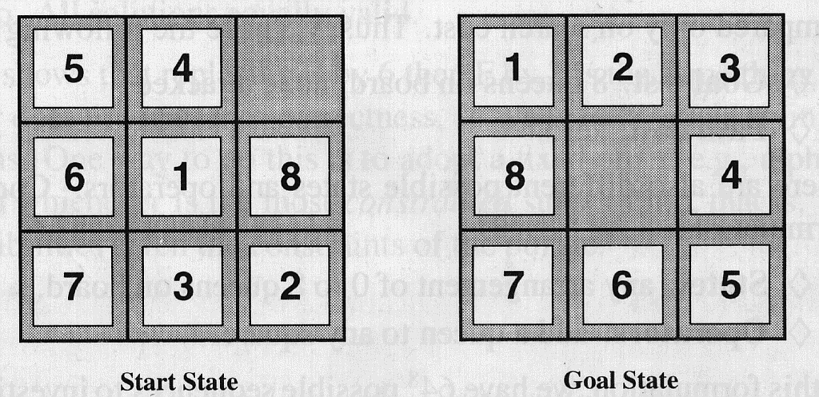
Example: 8-puzzle
h₁: number of tiles in the wrong position
h₂: sum of the Manhattan distances from their goal positions (no diagonals)
which one is best?
h₁ = 7
h₂ = 19
(2+3+3+3+4+2+0+2)

Slide 30
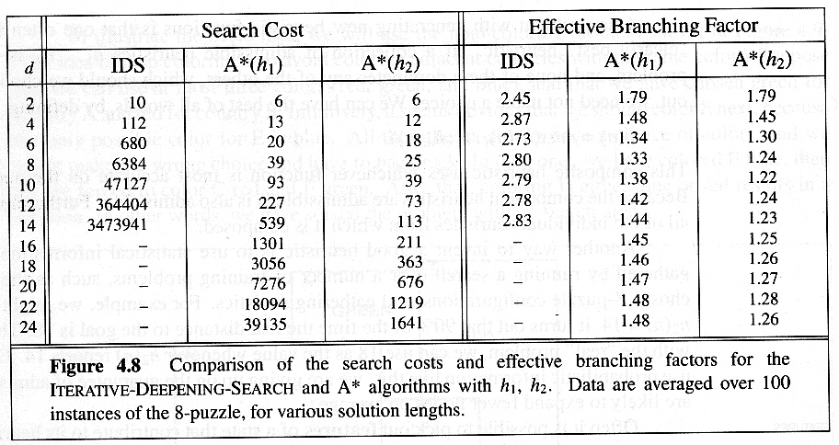
Performance comparison
Note: there are better heuristics for the 8-puzzle...

Slide 31
How to come up with heuristics?
Consider relaxed versions of the problem: remove constraints,
  8-puzzle: tiles cannot overlap
  Graph search: straight line distance
Assign weights:
f(n) = w1.g(n) + w2.h(n), w1+w2=1
Combine several functions:
f(n) = F(f₁(n),f₂(n),…,f_{k}(n)), F = max, sum
Apply cheapest heuristic function

Slide 32
IDA*: Iterative deepening A*
To reduce the memory requirements at the expense of some additional computation time, combine uninformed iterative deepening search with A* (IDS expands in DFS fashion trees of depth 1,2, …)
Use an f-cost limit instead of a depth limit

Slide 33
IDA* Algorithm - Top level
function IDA*(problem) returns solution
root := Make-Node(Initial-State[problem])
f-limit := f-Cost(root)
loop do
solution, f-limit := DFS-Contour(root, f-limit)
if solution is not null, then return solution
if f-limit = infinity, then return failure
end

Slide 34
IDA* contour expansion
function DFS-Countour(node,f-limit)
returns solution sequence and new f-limit
if f-Cost[node] > f-limit then return (null, f-Cost[node] )
if Goal-Test[problem](State[node]) then return (node,f-limit)
for each node s in Successor(node) do
solution, new-f := DFS-Contour(s, f-limit)
if solution is not null, then return (solution, f-limit)
next-f := Min(next-f, new-f); end
return (null, next-f)

Slide 35
IDA* on graph example
S
11.9
A
13.4
D
12.4
B
13.7
D
16.9
A
19.4
E
12.9
14.0
19.9
16.9
19.7
17.7
13.0
C
E
E
B
B
F
14.0
20.0
21.7
17.0
21.0
24.9
25.4
19.0
13.0
D
F
B
F
C
E
A
C
G
0.0
4.0
0.0
3.0
G
C
G
F
0.0
G

Slide 36
IDA* trace
Level 0:
IDA(S, 11.9)
11.9
Level 1:
IDA(S, 11.9)
IDA(A, 11.9)
13.4
IDA(D, 11.9)
12.4
Level 2:
IDA(S, 12.4)
IDA(A, 12.4)
13.4
IDA(D, 12.9)
IDA(A, 12.9)
19.4
IDA(E, 12.9)
12.9
Level 3:
IDA(S, 12.9)
IDA(F, 12.9)
13.0

Slide 37
Simplified Memory-Bounded A*
IDA* repeats computations, but only keeps bd nodes in the queue.
When more memory is available, more nodes can be kept, and avoid repeating those nodes
Need to delete nodes from the A* queue (forgotten nodes). Drop those with higher f-cost values first
Remember ancestor nodes information about best path so far, so those with lower values will be expanded next

Slide 38
SMA* mode of operation
Expand deepest least cost node
Forget shallowest highest cost
Remember value of best forgotten successor
Non-goal at maximum depth is infinity
Regenerates a subtree only when all other paths have been shown to be worse than the path it has forgotten.

Slide 39
SMA* properties
Checks for repetitions of nodes in memory
Complete when there is enough space to store the shallowest solution path
Optimal if enough memory available for the shallowest optimal solution path. Otherwise, it returns the best solution reachable with available memory
When enough memory for the entire search tree, search is optimally efficient (A*)

Slide 40
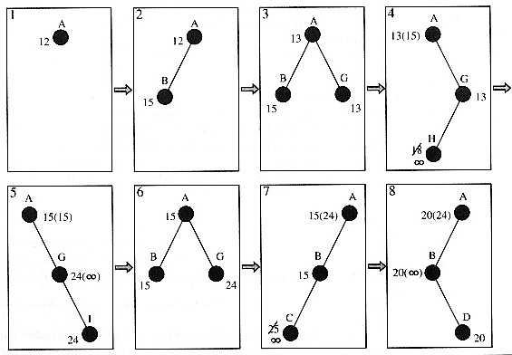
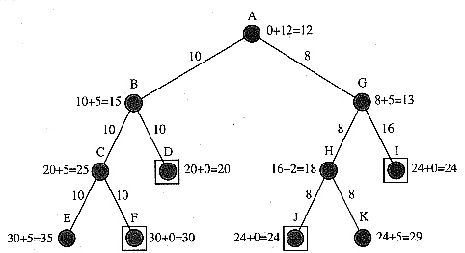

An example with 3 node memory

Slide 41
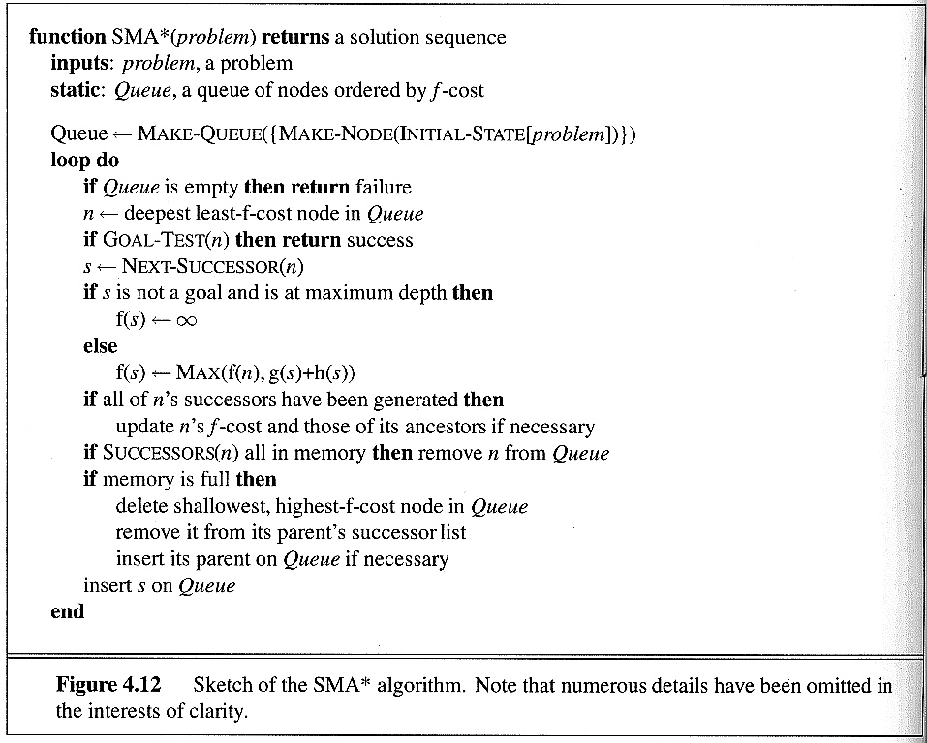
Outline of the SMA* algorithm

Slide 42
Iterative improvement algorithms
What if the goal is not known? We only know how to compare two states and say which one is best:
  earn as much money as possible
  pack the tiles in the smallest amount of space
  reduce the number of conflicts in a schedule
Start with a legal state, and try to improve it
Cannot guarantee to find the optimal solution, can produce the best solution so far
Minimization/maximization problem

Slide 43
Hill climbing strategy
Apply the rule that increases the most the current state value
Move in the direction of the greatest gradient
f-value
f-value = max(state)
states
while f-value(state) > f-value(best-next(state))
state := next-best(state)

Slide 44
Hill climbing -- Properties
Called gradient descent method in optimization
Will stop at a local maximum (minimum) with no clue on how to proceed next
Performs random search for equal values (plateau)
Requires a strategy for escaping a local minimum: random jump, backtrack, etc

Slide 45


Simulated annealing
Proceed like hill climbing, but pick at each step a random move
If the move improves the f-value, it is always executed
Otherwise, it is executed with a probability that decreases exponentially as improvement is not found
Probability function:
  T is the number of steps since improvement
  is the amount of decrease at each step

Slide 46
Simulated annealing algorithm
function Simulated-Annealing(problem, schedule) returns solution state
current := Make-Node(Initial-State[problem])
for t := 1 to infinity
T := schedule[t]
if T = 0 then return current
next := Random-Successor(current)
:= f-Value[next] - f-Value[current]
if > 0 then current := next
else current := next with probability
end

Slide 47
Analogy to physical process
Annealing is the process of cooling a liquid until it freezes (E energy, T temperature).
The schedule is the rate at which the temperature is lowered
Individual moves correspond to random fluctuations due to termal noise
One can prove that if the temperature is lowered sufficiently slowly, the material will attain its state of lowest energy configuration (global minimum)

Slide 48
AND/OR graphs
Some problems are best represented as achieving subgoals, some of which achieved simultaneously and independently (AND)
Up to now, only dealt with OR options
Possess TV set
Steal TV
Earn Money
Buy TV

Slide 49
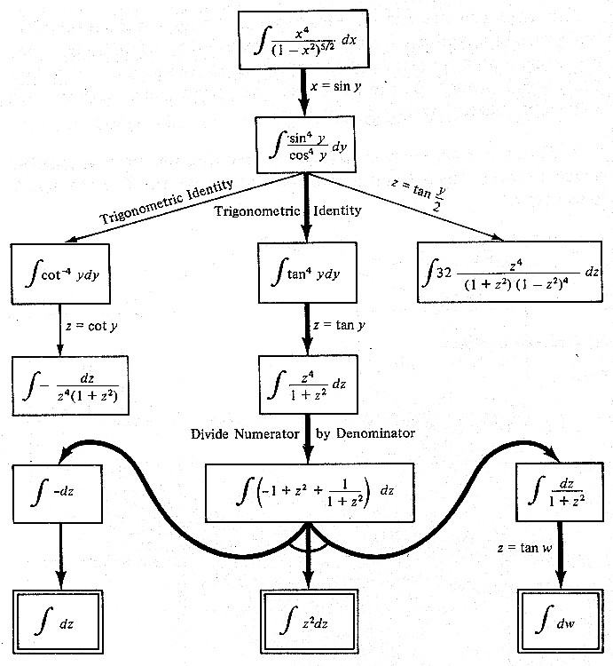
AND/OR tree for symbolic integration

Slide 50
Grammar parsing
F
F → EA
F → DD
E → DC
E → CD
D → F
D → A
C → A
A → a
D → d
E
A
D
D
D
C
C
D
A
A
A
A
Is the string ada in the language?

Slide 51
Searching AND/OR graphs
Hyperhgraphs: OR and AND connectors to several nodes - consider trees only
Generate nodes according to AND/OR rules
A solution in an AND-OR tree is a subtree (before, a path) whose leafs (before, a single node) are included in the goal set
Cost function: sum of costs in AND node f(n) = f(n₁) + f(n₂) + …. + f(n_{k})
How can we extend Best-First-Search and A* to search AND/OR trees? The AO* algorithm.

Slide 52
AND/OR search: observations
We must examine several nodes simultaneously when choosing the next move
Partial solutions are subtrees - they form the solution bases
A
38
B
C
D
17
9
27
E
F
G
H
I
J
(5)
(10)
(3)
(4)
(15)
(10)

Slide 53
AND/OR Best-First-Search
Traverse the graph (from the initial node) following the best current path.
Pick one of the unexpanded nodes on that path and expand it. Add its successors to the graph and compute f for each of them, using only h
Change the expanded node’s f value to reflect its successors. Propagate the change up the graph.
Reconsider the current best solution and repeat until a solution is found

Slide 54
AND/OR Best-First-Search example
1.
2.
A
A
(5)
(9)
D
(3)
B
(5)
C
(4)
3.
A
D
(10)
(9)
B
C
(3)
(4)
(10)
E
F
(4)
(4)

Slide 55
AND/OR Best-First-Search example
4.
A
(12)
B
C
D
(10)
(6)
(4)
(10)
G
H
(7)
E
F
(5)
(4)
(4)

Slide 56
AO* algorithm
Best-first-search strategy with A* properties
Cost function f(n) = g(n) + h(n)
  g(n) = sum of costs from root to n
  h(n) = sum of estimated costs from n to goal
When h(n) is monotone and always underestimates, the strategy is admissible and optimal
Proof is much more complex because of update step and termination condition

Slide 57

AO* algorithm (1)
1. Create a search tree G with starting node s.
OPEN:= s; G₀ := s (the best solution base)
While the solution has not been found, do 2-8
2. Trace down the marked connectors of subgraph G₀ and inspect its leafs
3. If OPEN G₀ = 0 then return G₀
4. Select an OPEN node n in G₀ using a selection function f₂ . Remove n from OPEN
5. Expand n, generating all its successors and put them in G, with pointers back to n

Slide 58

AO* algorithm (2)
6. For each successor m of n
- if m is non-terminal, compute h(m).
- if m is terminal, h(m) := g(m) and delete(m,OPEN)
- if m is not solvable, set h(m) to
- if m is already in G, h(m) := f(m)
7. Revise the f value of n and all its ancestors. Mark the best arc from every updated node in G₀
8. If f(s) is updated to return failure. Else remove from G all nodes that cannot influence the value of s.

Slide 59
Informed search: summary
Expand nodes in the search graph according to a problem-specific heuristics that account for the cost from the start and estimate the cost of reaching the goal
A* search: when the estimate is always optimistic, the search strategy will produce an optimal solution
Designing good heuristic functions is the key to effective search
Introducing randomness in search helps escape local maxima

Slide 60
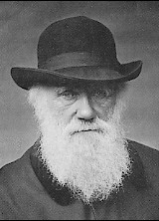

Genetic Algorithms
Beagle Voyage
Animals adopt to
environmental.

Slide 61
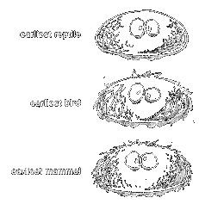
Genetic Algorithms
Natural Evolution:
  Given these requirements:
    A creature whose features affects his reproduction rate.
    Offspring features are very much, but not exactly similar to the parent(s).
    There is a competition on resources.
  We will have
    Gradual Progress
  The Blind Watchmaker - Dawkins

Slide 62

Genetic algorithms
Start with k randomly generated states (population)
A successor state is generated by combining two parent states
Produce the next generation of states by selection, crossover, and mutation.
Evaluation function (fitness function). Higher values for better states.
  Selection of Higher Fitnesses

Slide 63

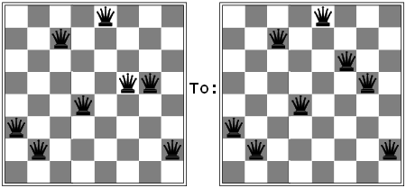
Genetic algorithms
Cross Over:
  To select some part of the solution (state) from one person and the rest from another.
Mutation:
  To change a small part of one solution with a small probability.

Slide 64
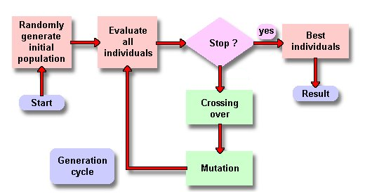
Genetic algorithms

Slide 65
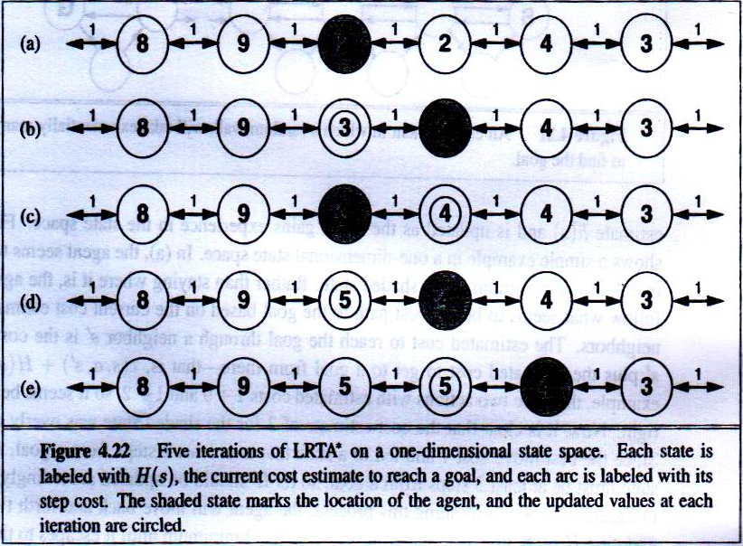
Learning Real Time A*
To remember and update the costs of all visited nodes.

Slide 66
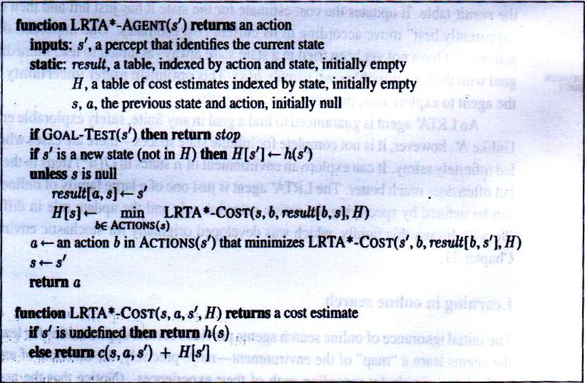
Learning Real Time A*

